Slide 1
Project Title
Power BI Enabled Comprehensive Analysis of Unicorn Businesses
BY Mangesh Pawar
Abstract | Problem Statement | Project Overview | Proposed Solution | Technology Used | Modelling & Results | Conclusion | Q&A

Slide 2
Abstract
1
In this project we analyzed the unique and highly successful businesses known as “Unicorns”.
2
Unicorns are the companies that have achieved a valuation of $1 billion or more.
3
We try to find out how many unicorns are there ,average time to become unicorn,and how many industries have unicorns etc.
4
We try to find out which industry have most unicorns,which investor funded most unicorns etc.

Slide 3


Problem Statement
Average years taken by company to become unicorn.
Which industry has most unicorns.
Which country has most unicorns.
Which year most companies became unicorns.
Which investor has funded most unicorns.
Total funding.
Total unicorns.

Slide 4

Project Overview
The goal of this project is to analyze unicorn businesses – companies valued at $1 billion or more.
The project will begin by defining a unicorn business and outlining its characteristics.
The project will answer questions like how any years taken by startups to become unicorns ,which industry is more successful for unicorns ,which country is best for unicorn businesses ,which investors funded the most unicorns etc.

Slide 5
Proposed Solution
For comprehensive analysis of unicorn businesses we will collect data from public sources, company filings, investment reports and funding announcements.
Our analysis will focus on :
The industries and sectors that attracts unicorn investments , such as Fintech ,AI ,E-Commerce etc
The growth and trajectory of unicorn investment over time ,including emerging markets and regions.
To analyze and visualize our findings we will use Power BI power query and we will create dashboard using maps ,slicers , matrix, stacked bar, pie chart,card, and stacked column charts

Slide 6
Technology used
Power BI

Slide 7
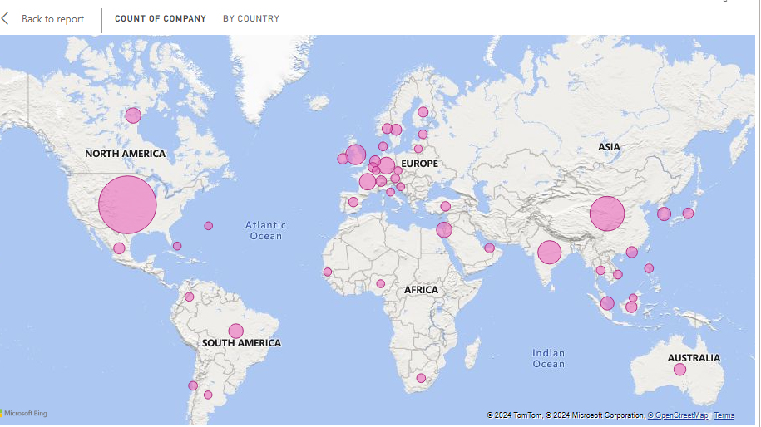
Modelling & Result

Slide 8
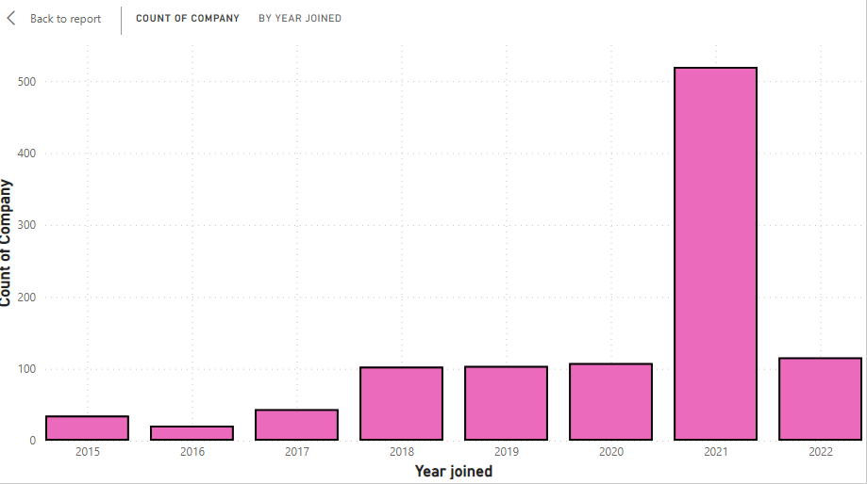
Modelling & Result

Slide 9
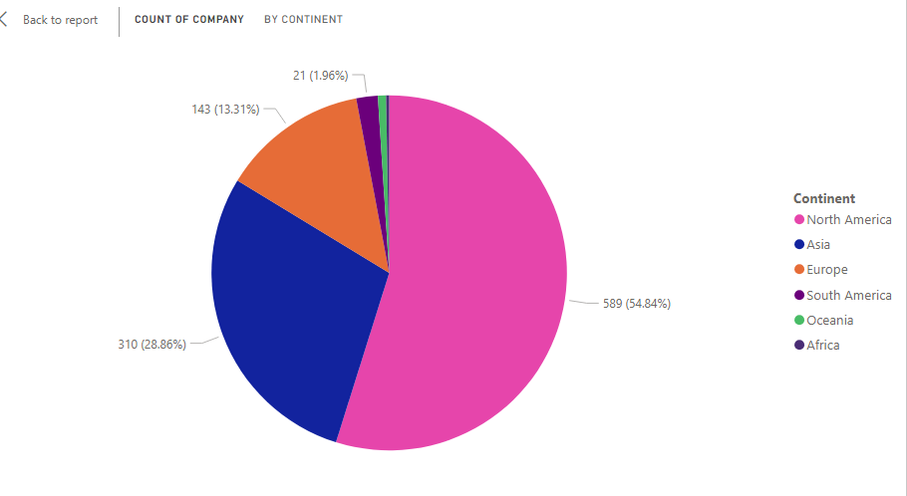
Modelling & Result

Slide 10
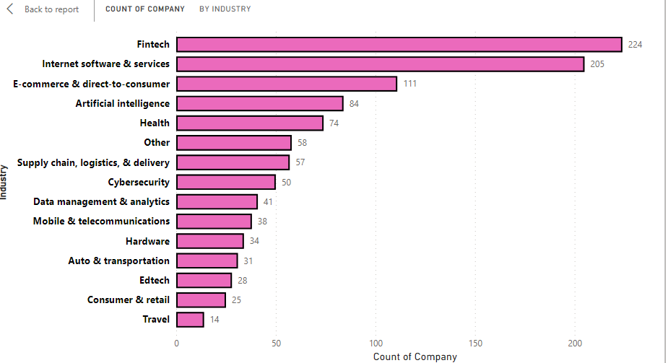
Modelling & Result

Slide 11
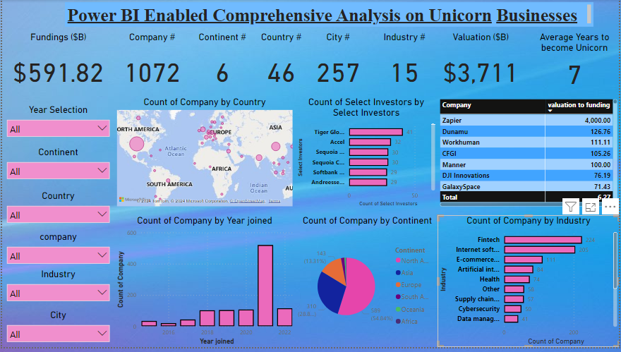
Modelling & Result

Slide 12

Conclusion
Average years to become unicorn for any company is 7 years.
United State of America has most unicorns ,around 562.
The industry that has most unicorn is Fintech industry.
2021 was the most successful year ,around 520 companies became unicorns.
North America is the continent which has the most unicorns.
Tiger Global Management has funded most unicorns , around 41.
Zapier is the unicorn ,which has given the most ROI , around 4000%

Slide 13


Notes:
Thank You !!

